Slide 1


GROUP 5
Enhanced Sensor Validation & Debouncing in AUTOSAR
This presentation details how to enhance sensor validation and debouncing within an AUTOSAR-based system. We'll explore the critical roles of Basic Software (BSW) modules and their structured interactions with application software components (SWCs) for robust fault handling.
NAME | SLIDE
USHA | 1-3
SUMA | 4-6
DEEPAK | 7-9
JYOTISMAN | 10-11
PRINCE | MADE PPT
VIKAS | MADE PPT

Slide 2
AGENDA
Key Components of AUTOSAR Fault Management
Understanding Diagnostic Events
1
Defining and reporting sensor health from SWCs.
Debouncing Mechanisms
2
Exploring counter-based and time-based approaches in the DEM.
Advanced Debouncing
3
Utilising Monitor Internal Debouncing for complex scenarios.
Function Inhibition & Fail-Safe
4
Managing system behaviour post-fault with FIM.

Slide 3
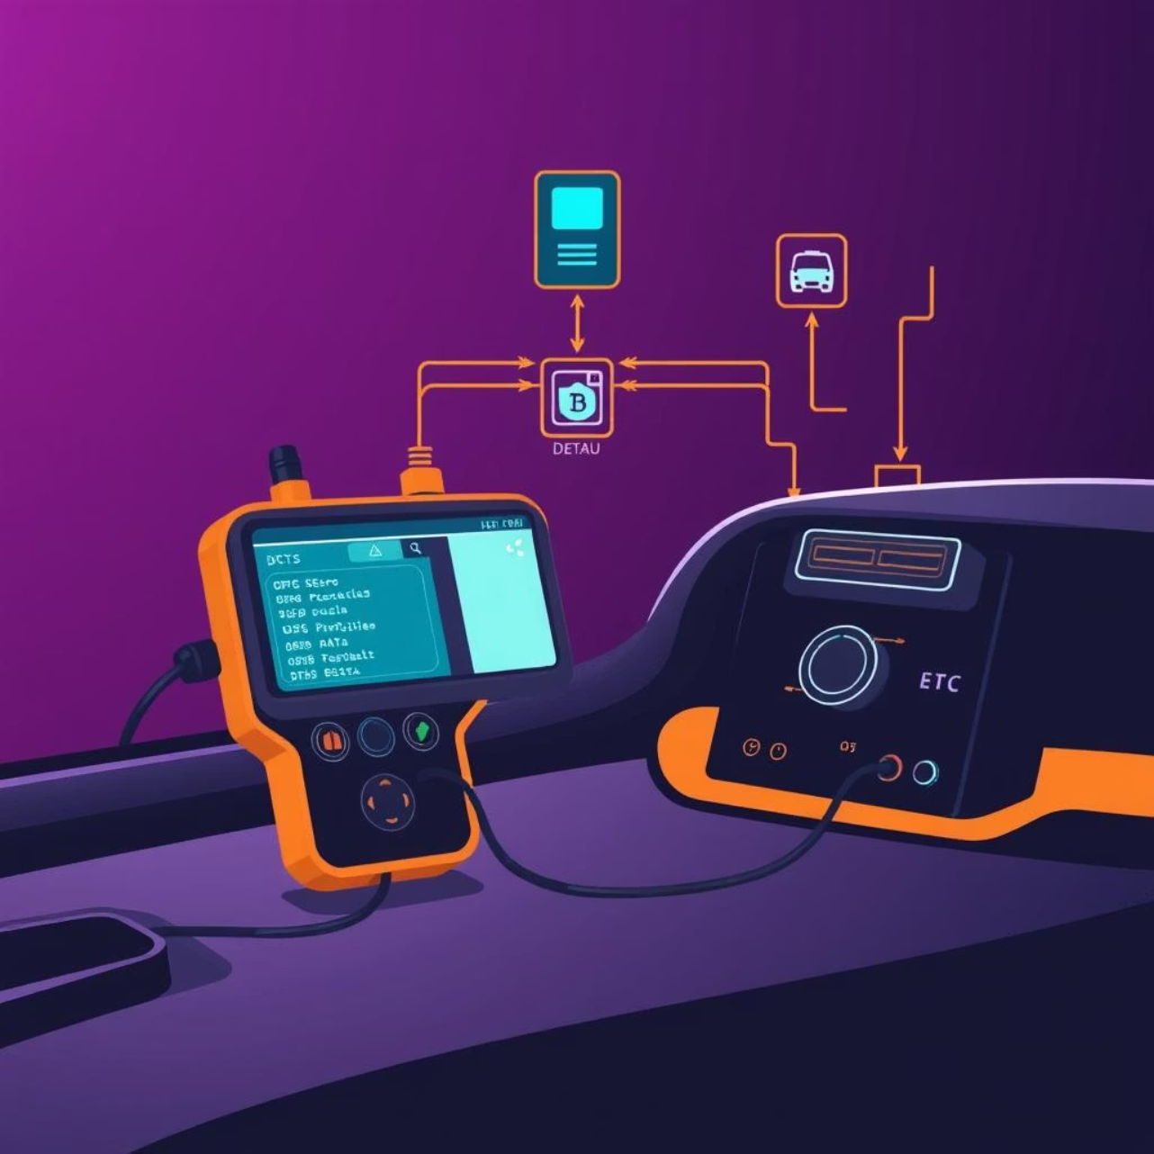
The Diagnostic Event Manager (DEM)
The Diagnostic Event Manager (DEM) is the central module in AUTOSAR for handling diagnostic events. It processes, debounces, and stores fault information, making it accessible to other modules like the Diagnostic Communication Manager (DCM).
Central Hub: Manages all diagnostic events from various SWCs.
Debouncing: Filters out transient sensor anomalies to prevent false positives.
Fault Storage: Retains critical fault data for later analysis and communication.
Interoperability: Interfaces seamlessly with DCM for diagnostic tester communication.

Slide 4


Defining Diagnostic Events in the SWC
Sensor Monitoring Logic
Reporting to the DEM
The Application SWC implements core logic to check sensor health. This includes:
Upon fault detection, the SWC reports the status of a pre-configured diagnostic event to the DEM via a client-server port interface.
Range Checks: Verifying values against physical limits.
Uses Dem_SetEventStatus() API.
Plausibility Checks: Comparing values with related signals for consistency.
Reports DEM_EVENT_STATUS_PREFAILED for new faults.
Rate of Change Checks: Ensuring values change within physically possible rates.
Reports DEM_EVENT_STATUS_PREPASSED if the fault condition clears.

Slide 5


Debouncing Mechanisms in the DEM
The DEM centralises debouncing logic, making SWCs portable. AUTOSAR defines three primary mechanisms to filter transient faults.
Counter-based Debouncing
Time-based Debouncing
Maintains a fault counter. Increments for PREFAILED, decrements for PREPASSED. Fault matures when counter hits a configurable "fault threshold"; heals when reaching a "healing threshold." Ideal for noisy signals with expected transient spikes.
Starts a timer upon PREFAILED. If PREPASSED occurs before timer expires, it resets. Fault matures only if PREFAILED persists for a "debounce time." Best for signal dropouts or transient faults requiring a sustained duration to be considered genuine.

Slide 6

Counter-based Debouncing in Detail
How it works: The DEM maintains a counter for each diagnostic event.
Increment: Counter increases when SWC reports PREFAILED.
Decrement: Counter decreases when SWC reports PREPASSED.
Fault Threshold: Configured value (e.g., 5 counts) at which fault matures to a "Confirmed DTC."
Healing Threshold: Configured value (e.g., -5 counts) at which fault is considered "healed."
Use Case: Effectively filters short, noisy signal spikes where transient bad readings are acceptable, but a sustained problem indicates a true fault condition.

Slide 7

Time-based Debouncing in Detail
How it works: The DEM starts a timer for the event when the SWC reports PREFAILED.
Timer Reset: If SWC reports PREPASSED before timer expires, the timer resets.
Debounce Time: Configurable duration (e.g., 100 ms). Fault matures only if PREFAILED persists for this full time.
Use Case: Robust for signal dropouts or faults that are inherently transient but require a minimum duration to be considered genuine. Example: handling momentary loss of a CAN message.

Slide 8

Monitor Internal Debouncing
This mechanism allows the Application SWC to implement its own custom debouncing algorithm, providing flexibility for complex fault detection scenarios.
Custom Logic: SWC employs sophisticated filters, state machines, or combined checks.
Direct Reporting: SWC reports matured status ( DEM_EVENT_STATUS_FAILED or DEM_EVENT_STATUS_PASSED) directly to the DEM.
Immediate Update: DEM updates the DTC status byte immediately, bypassing further internal debouncing.
Use Case: Ideal for complex fault conditions that exceed the capabilities of standard counter or time-based debouncing.

Slide 9



Function Inhibition and Fail-Safe Management
Fault Maturation
Function Inhibition Manager (FIM)
Fail-Safe Activation
Once a diagnostic event matures (debouncing complete), the DEM sets the TestFailed bit in the DTC Status Byte, initiating the fail-safe sequence.
When the DEM reports a mature fault, FIM sets the corresponding FID to "inhibit." The application SWC calls FiM_GetFunctionPermission(); if inhibited, it executes fail-safe logic, e.g., derating engine power.
The FIM, a central BSW module, links mature diagnostic events to the inhibition of specific functions. FIDs are configured and linked to diagnostic events.

Slide 10

Key Takeaways
Layered Architecture
AUTOSAR ensures clear separation of concerns, enhancing development, testing, and maintenance efficiency.
SWC Focus
Application SWCs focus on sensor monitoring logic, reporting status to the DEM.
DEM & FIM Roles
DEM handles debouncing and fault management, while FIM orchestrates function inhibition and fail-safe actions.
High Configurability
The system offers extensive configurability to adapt to diverse OEM requirements.

